Slide 1
Antenna Tuners
What they can do for you and how do they do it?
By: Glenn Kurzenknabe, K3SWZ

Slide 2
One of the rages today is Ham Radio is that you must have an Antenna Tuner!
The truth is, you may not really need one!

Slide 3
This presentation was prompted by a chance meeting on 20 Meters one night with a new local ham that I had never met. He asked if he could call me on the landline.
Seems that he just got on the air and guys on the net that he frequented told him he “needed an Amplifier and an Antenna Tuner”!
He spent a good bit of money and had nothing to show for it. He was clearly just turning knobs, having no idea what he was trying to accomplish with either box. A trip to his QTH got him squared away and all is hopefully well. I don’t think he still understands, but he does know how to tune the system.

Slide 4
We will review if and why you need an Antenna Tuner and how to tune it.

Slide 5
The term “Antenna Tuner” is misleading. They do not actually “tune” the antenna. Simply, they provide a suitable match from the antenna to the RF source (radio or amplifier) whereby maximum power transfer takes place and the source is happy.
Sometimes called a “Transmatch”

Slide 6
Remember: An Antenna Tuner cannot make a BAD antenna GOOD!
This is very important and cannot be over stressed!

Slide 7
Every antenna has a Resonant point. That is the frequency where the antenna is “perfectly” matched. As you move up and down from that frequency, the antenna presents a complex load to the radio or amplifier feeding it. Moving too far may present problems.

Slide 8
What is a complex load?
A complex load, simply stated, is a load that has reactive components.
Reactive components being XL and XC.
Most antennas exhibit complex loads, while radios are purely resistive.

Slide 9
If your transceiver has a built-in automatic antenna tuner, then you most likely don’t need an external tuner. The exception to this rule, is if you have a terribly mis-matched antenna and the built-in tuner cannot handle it. You really shouldn’t be using that configuration anyway!

Slide 10
Antenna Tuners consist of coils and capacitors, that when adjusted properly, allow for maximum power transfer. These device are not loss free! Tuners exhibit what is called “Insertion Loss”. Not a big deal, but worth mentioning.

Slide 11
There are two types of Antenna Tuners.
Manual and Automatic.
Tuners built into transceivers are automatic and outboard ones are generally manual. The exception to this is that there are several automatic, external tuners built by MFJ, LDG and a possibly few others.

Slide 12
We live in a 50 Ohm world!
Antenna Tuners can handle a wide range of impedance mis-matches. “Mis-match” means, how far one strays from 50 ohms. Generally, these impedances are above 50 ohms and go as high as many thousands of ohms. (They can also go below 50 ohms) That is why it is critical to have a tuner with a wide range of tuning capability.

Slide 13
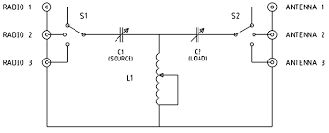

Slide 14
High impedance antennas are generally long wires. This narrative applies to them also. With Long Wire antennas, longer is better!
If the tuner doesn’t have a specific connector labeled “long wire” then use the output coax connector. Inside they are the same point.
50 Ohm antennas are dipoles, yagis or loops.
Antennas with less than 50 ohm impedance are verticals.

Slide 15
What is an L-Match?
An L-Match is simply a circuit that matches a “high impedance” to a “low impedance”. A Long Wire is matched to your 50 ohm radio. This is a very popular configuration, and goes back may years.

Slide 16
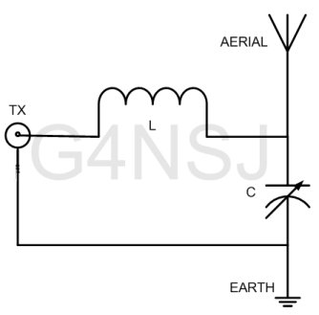

Slide 17
In order to tune a manual tuner, you must have a reasonably accurate SWR Bridge or RF Power meter, that can measure forward and reverse power.
This device is placed between the transceiver (or amplifier) and the Antenna Tuner! This is critical!

Slide 18
Some Antenna Tuners have built-in Power meters which are selectable for forward and reflected power.

Slide 19
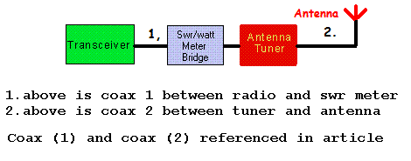

Slide 20
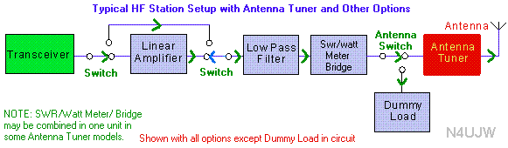

Slide 21
How do I tune my Antenna Tuner?
This can be accomplished in several ways
Makes sure your station is configured like one of the previous slides.
Set the controls on the tuner at mid-range. If you have a variable inductor (coil) set it at mid-range also. If it switched, you have to guess.

Slide 22
Now try tuning the variable caps and inductor for maximum noise in your transceiver. This will not be a big peak, so you have to listen carefully. This will get you in the ball park. Don’t panic if you don’t hear a big change in noise.

Slide 23
Put your transceiver on the frequency that you desire. Place it in the CW mode and hook up your key. (keyer off)
Put your inline power meter in the REFLECTED position.
Turn the internal antenna tuner OFF!
Turn the power control to zero output. You should be able to key your rig with zero RF output.
While sending long dashes, slowly turn up the output power until you
see some reflected power.
Stop keying and take a deep breath.

Slide 24
While holding the key down CAREFULLY adjust the capacitors and inductor on the tuner for MINIMUM Reflected power.
You will see some interaction between controls.
Once you have achieved zero or near zero reflected power, take another deep breath.
Turn the power output on you radio up to full and send a few dashes.
The reflected power should still be zero, or close to it. You can make some fine adjustment quickly.
Turn the internal tuner back on and let it make it’s final adjustments

Slide 25
Another method, is to pre-set the tuner, using a Dummy Load in place of the antenna. A Dummy Load is pure 50 Ohms! Follow the same procedure to tune the tuner into the Dummy Load. This will act like a “perfect” antenna. Once the tuner has been adjusted into the Dummy Load, switch to the antenna and follow the same procedure in the previous slides to tune the tuner. Using the Dummy Load gets you in the ball park.

Slide 26
Caution!
Some Antenna tuners have built-in Dummy Loads. Switching in this Dummy Load is NOT the same as connecting a Dummy Load to the output of the Antenna Tuner.

Slide 27
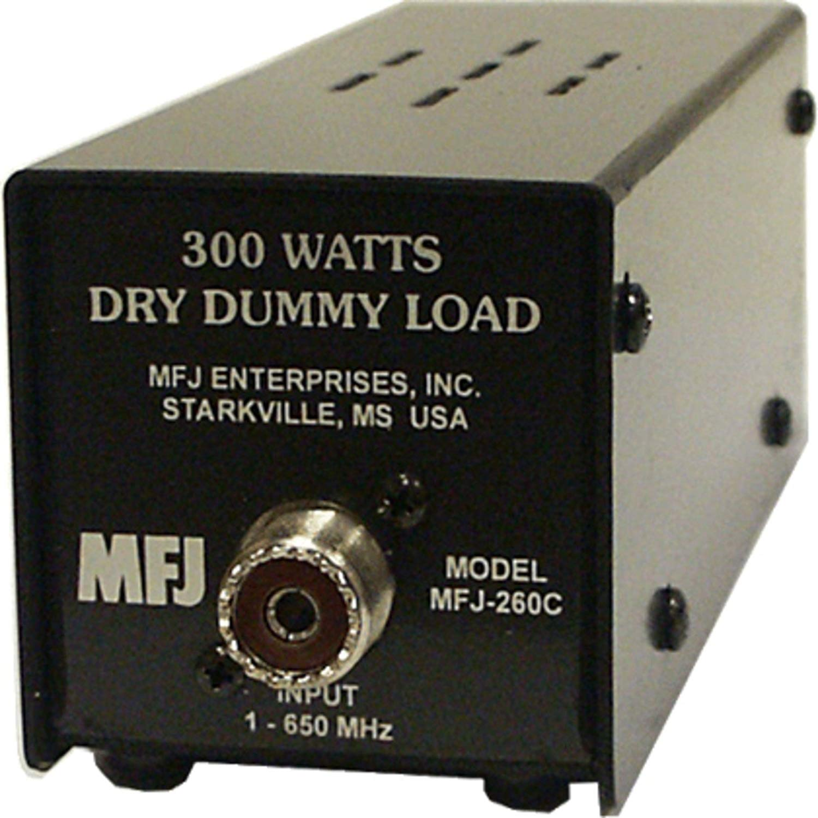

Slide 28
      An even better method is to replace the transceiver with an “Antenna Analyzer” such as the MFJ 259/269 series or equivalent. Simply connect a coax cable from the analyzer to the input of the tuner. (remove the radio) In this case the inline power meter can be ignored! Tune the analyzer to the desired frequency. Then adjust the controls on the tuner for minimum VSWR as expressed on the analyzer. You are NOT putting a signal on the air, so you can take as long as you wish. After successful tuning, you can replace the analyzer with the radio and again, follow the earlier steps for fine tuning

Slide 29
All three are good and they do work, Personally, I prefer the one using the analyzer, as it is more precise. After you have made your final adjustments make some notes of your pre-sets, so you can easily move around the bands.

Slide 30
Why was my internal Antenna Tuner turned OFF?
As your internal automatic Antenna Tuner senses changes in load impedance, it will try to make adjustments to correct these changes. The net result, is that you will never get anywhere. The internal tuner will try to “chase” any adjustments you make a you will never get there!

Slide 31
How do I tune my amplifier into the
Antenna Tuner?
After the Antenna Tuner has been adjusted properly, you can turn on your amplifier. Using reduced drive (input power) as you normally tune-up, you can adjust the amplifier into the tuner and make any final adjustments to the tuner, also. Be aware that tuning your amplifier will likely cause your internal tuner to adjust itself, so you have to keep all of this in mind! Actually, the automatic tuner in your radio may be on or off. Generally, the input to your amplifier presents a pretty good load, so the radio will be happy.

Slide 32
Your in-line or thru-line RF Power meter is your friend!
When adjusting the antenna tuner, you always use REFLECTED/REVERSE Power and when final adjusting the amplifier, you always use FORWARD Power.

Slide 33
All adjustments should be made slowly and methodically.
If you make wild adjustments, you might pass over the “sweet spots” that you are looking for and simply get nowhere.

Slide 34
What if I am using an Open Wire Transmission Line (Ladder Line)?
Some antenna Tuners are set-up for directly feeding balanced and coax transmission lines. If your tuner has this capability, the tuning procedure is exactly the same as a coax feedline.
If it is not, you will need an external Balun to change from a Balanced to Un-Balanced (coax) transmission line.
That is why it is called a “Bal-un”.
The Un-balanced output from the Balun goes to the coax antenna input on your tuner.

Slide 35
Can I build my own Antenna Tuner?
Yes! Antenna tuners are one of the easiest projects to build. They are simple (T-match circuit) Big capacitors and coils go un-loved at hamfests today.
In the case of Antenna Tuners, bigger is better. Capacitors with wide spacing are best, as they will not arc over, regardless of how much power you run. The ARRL Handbook has a number circuits over the years. You can tailor yours to the parts you can find.

Slide 36
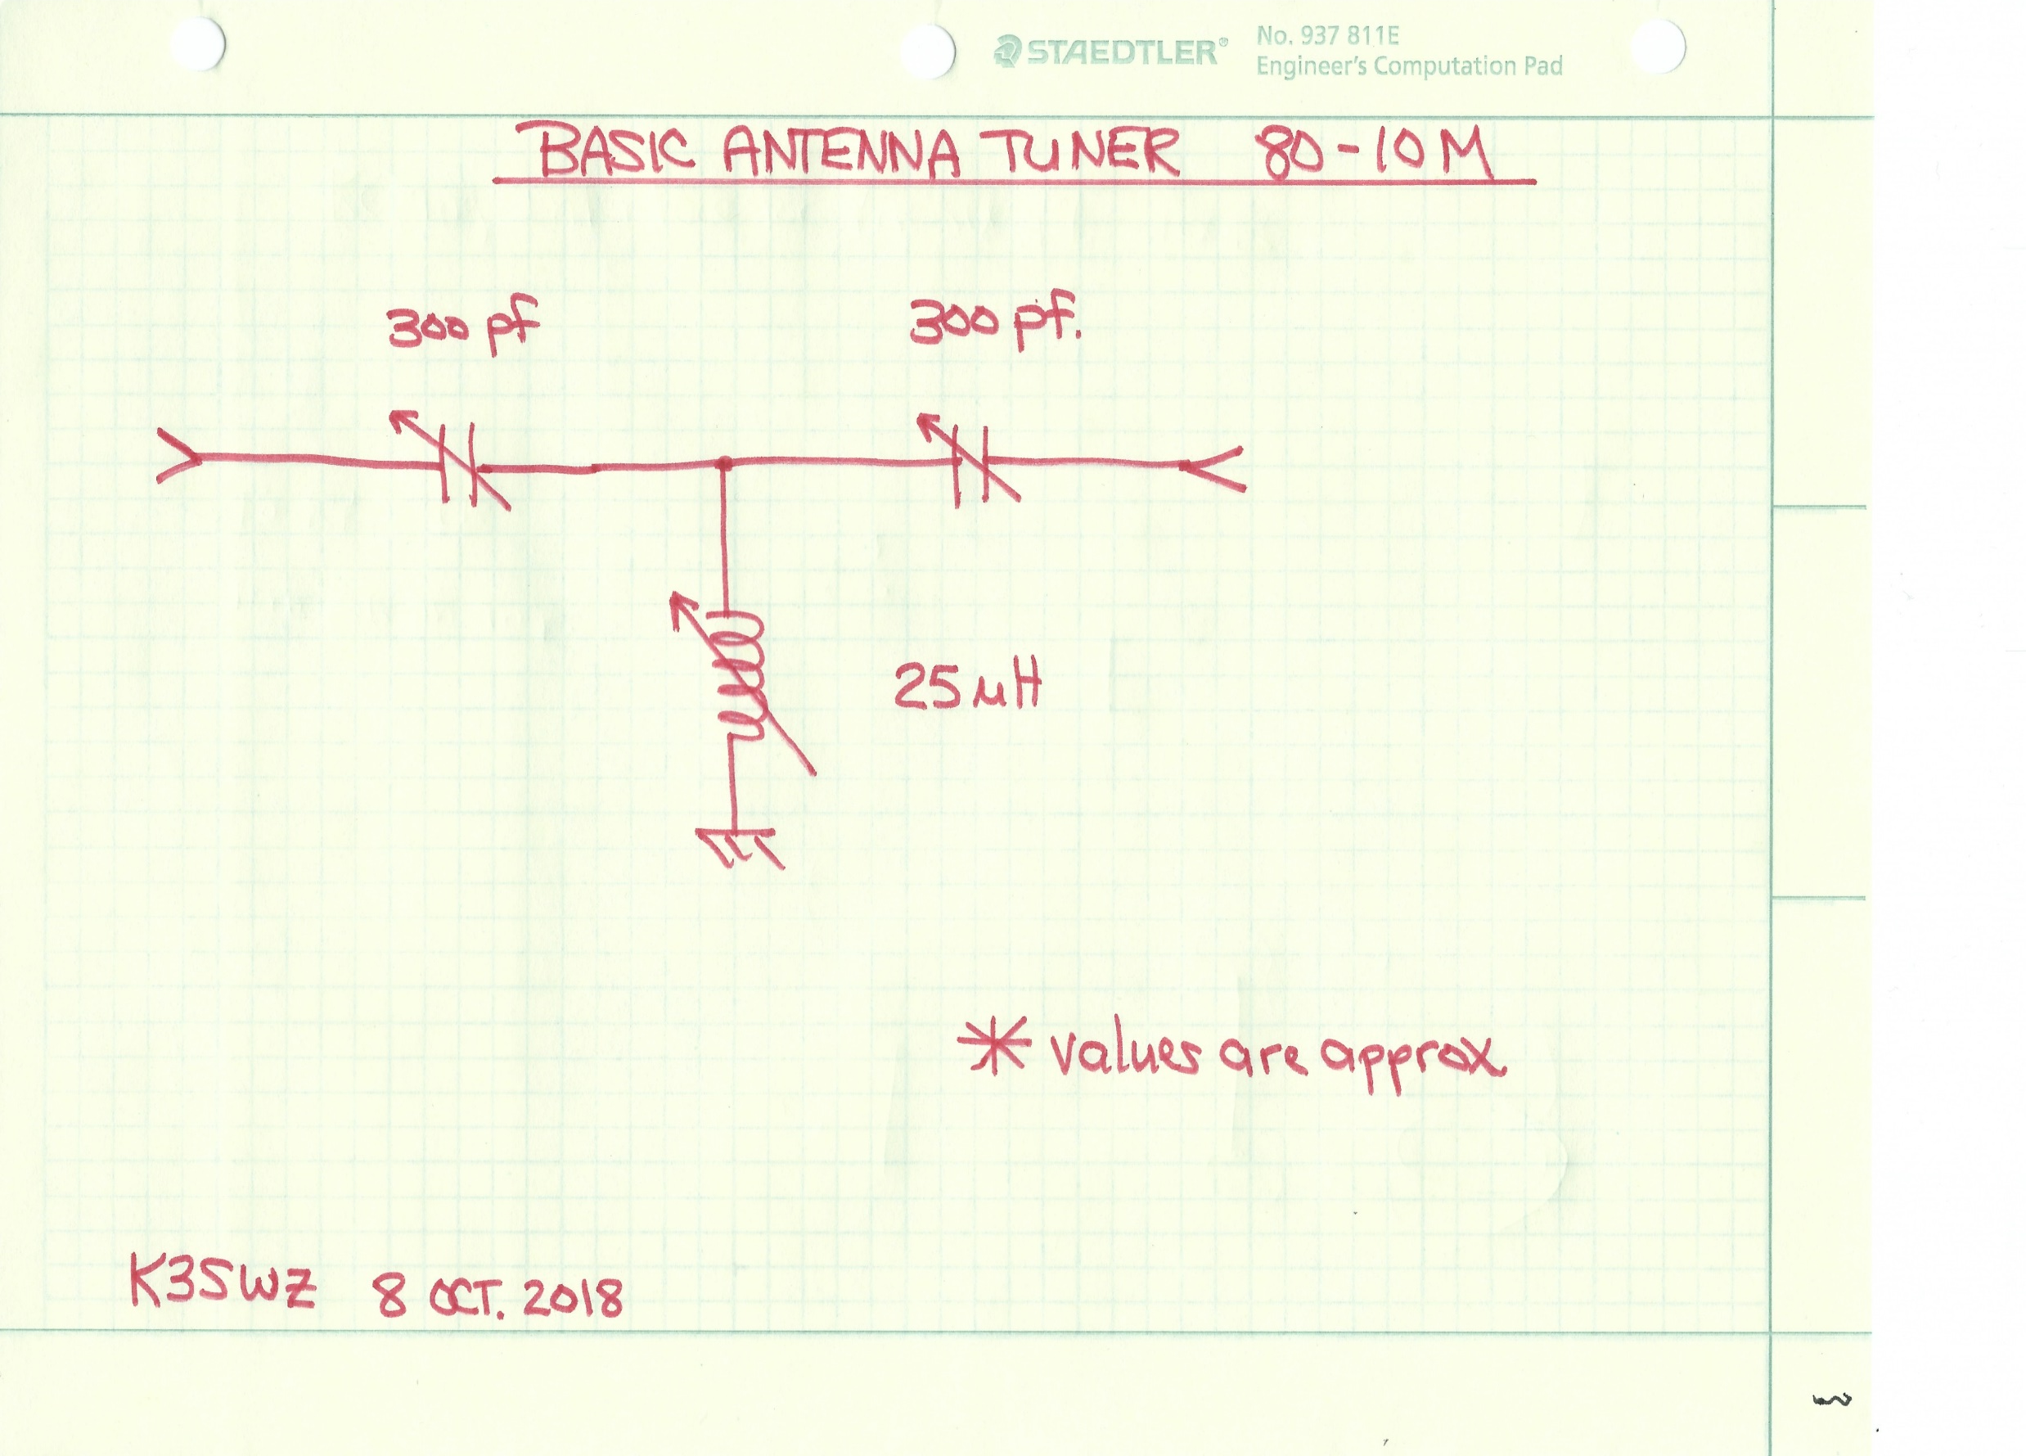
Basic Antenna Tuner circuit.

Slide 37
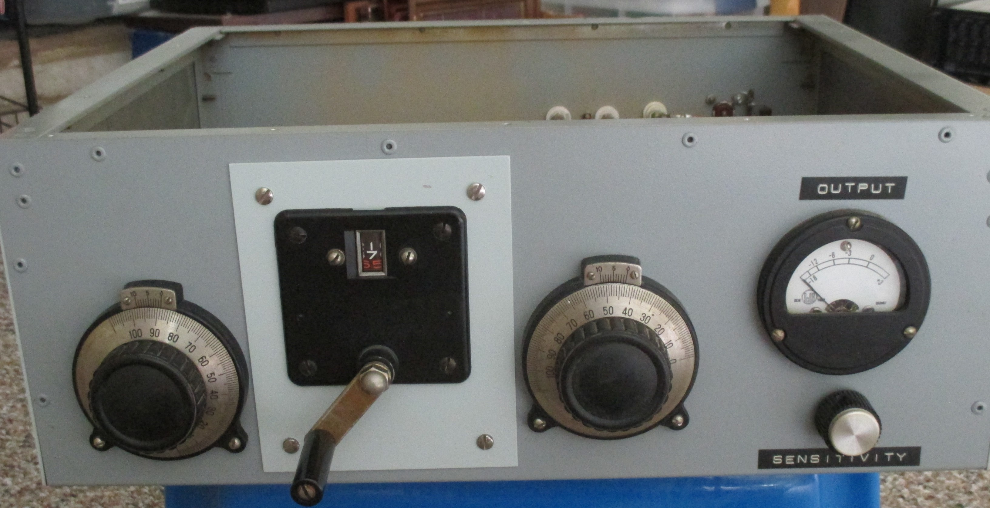

Slide 38
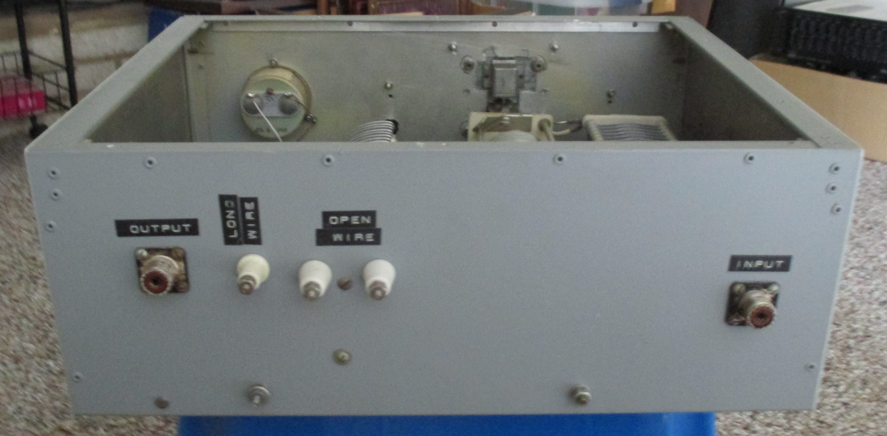

Slide 39
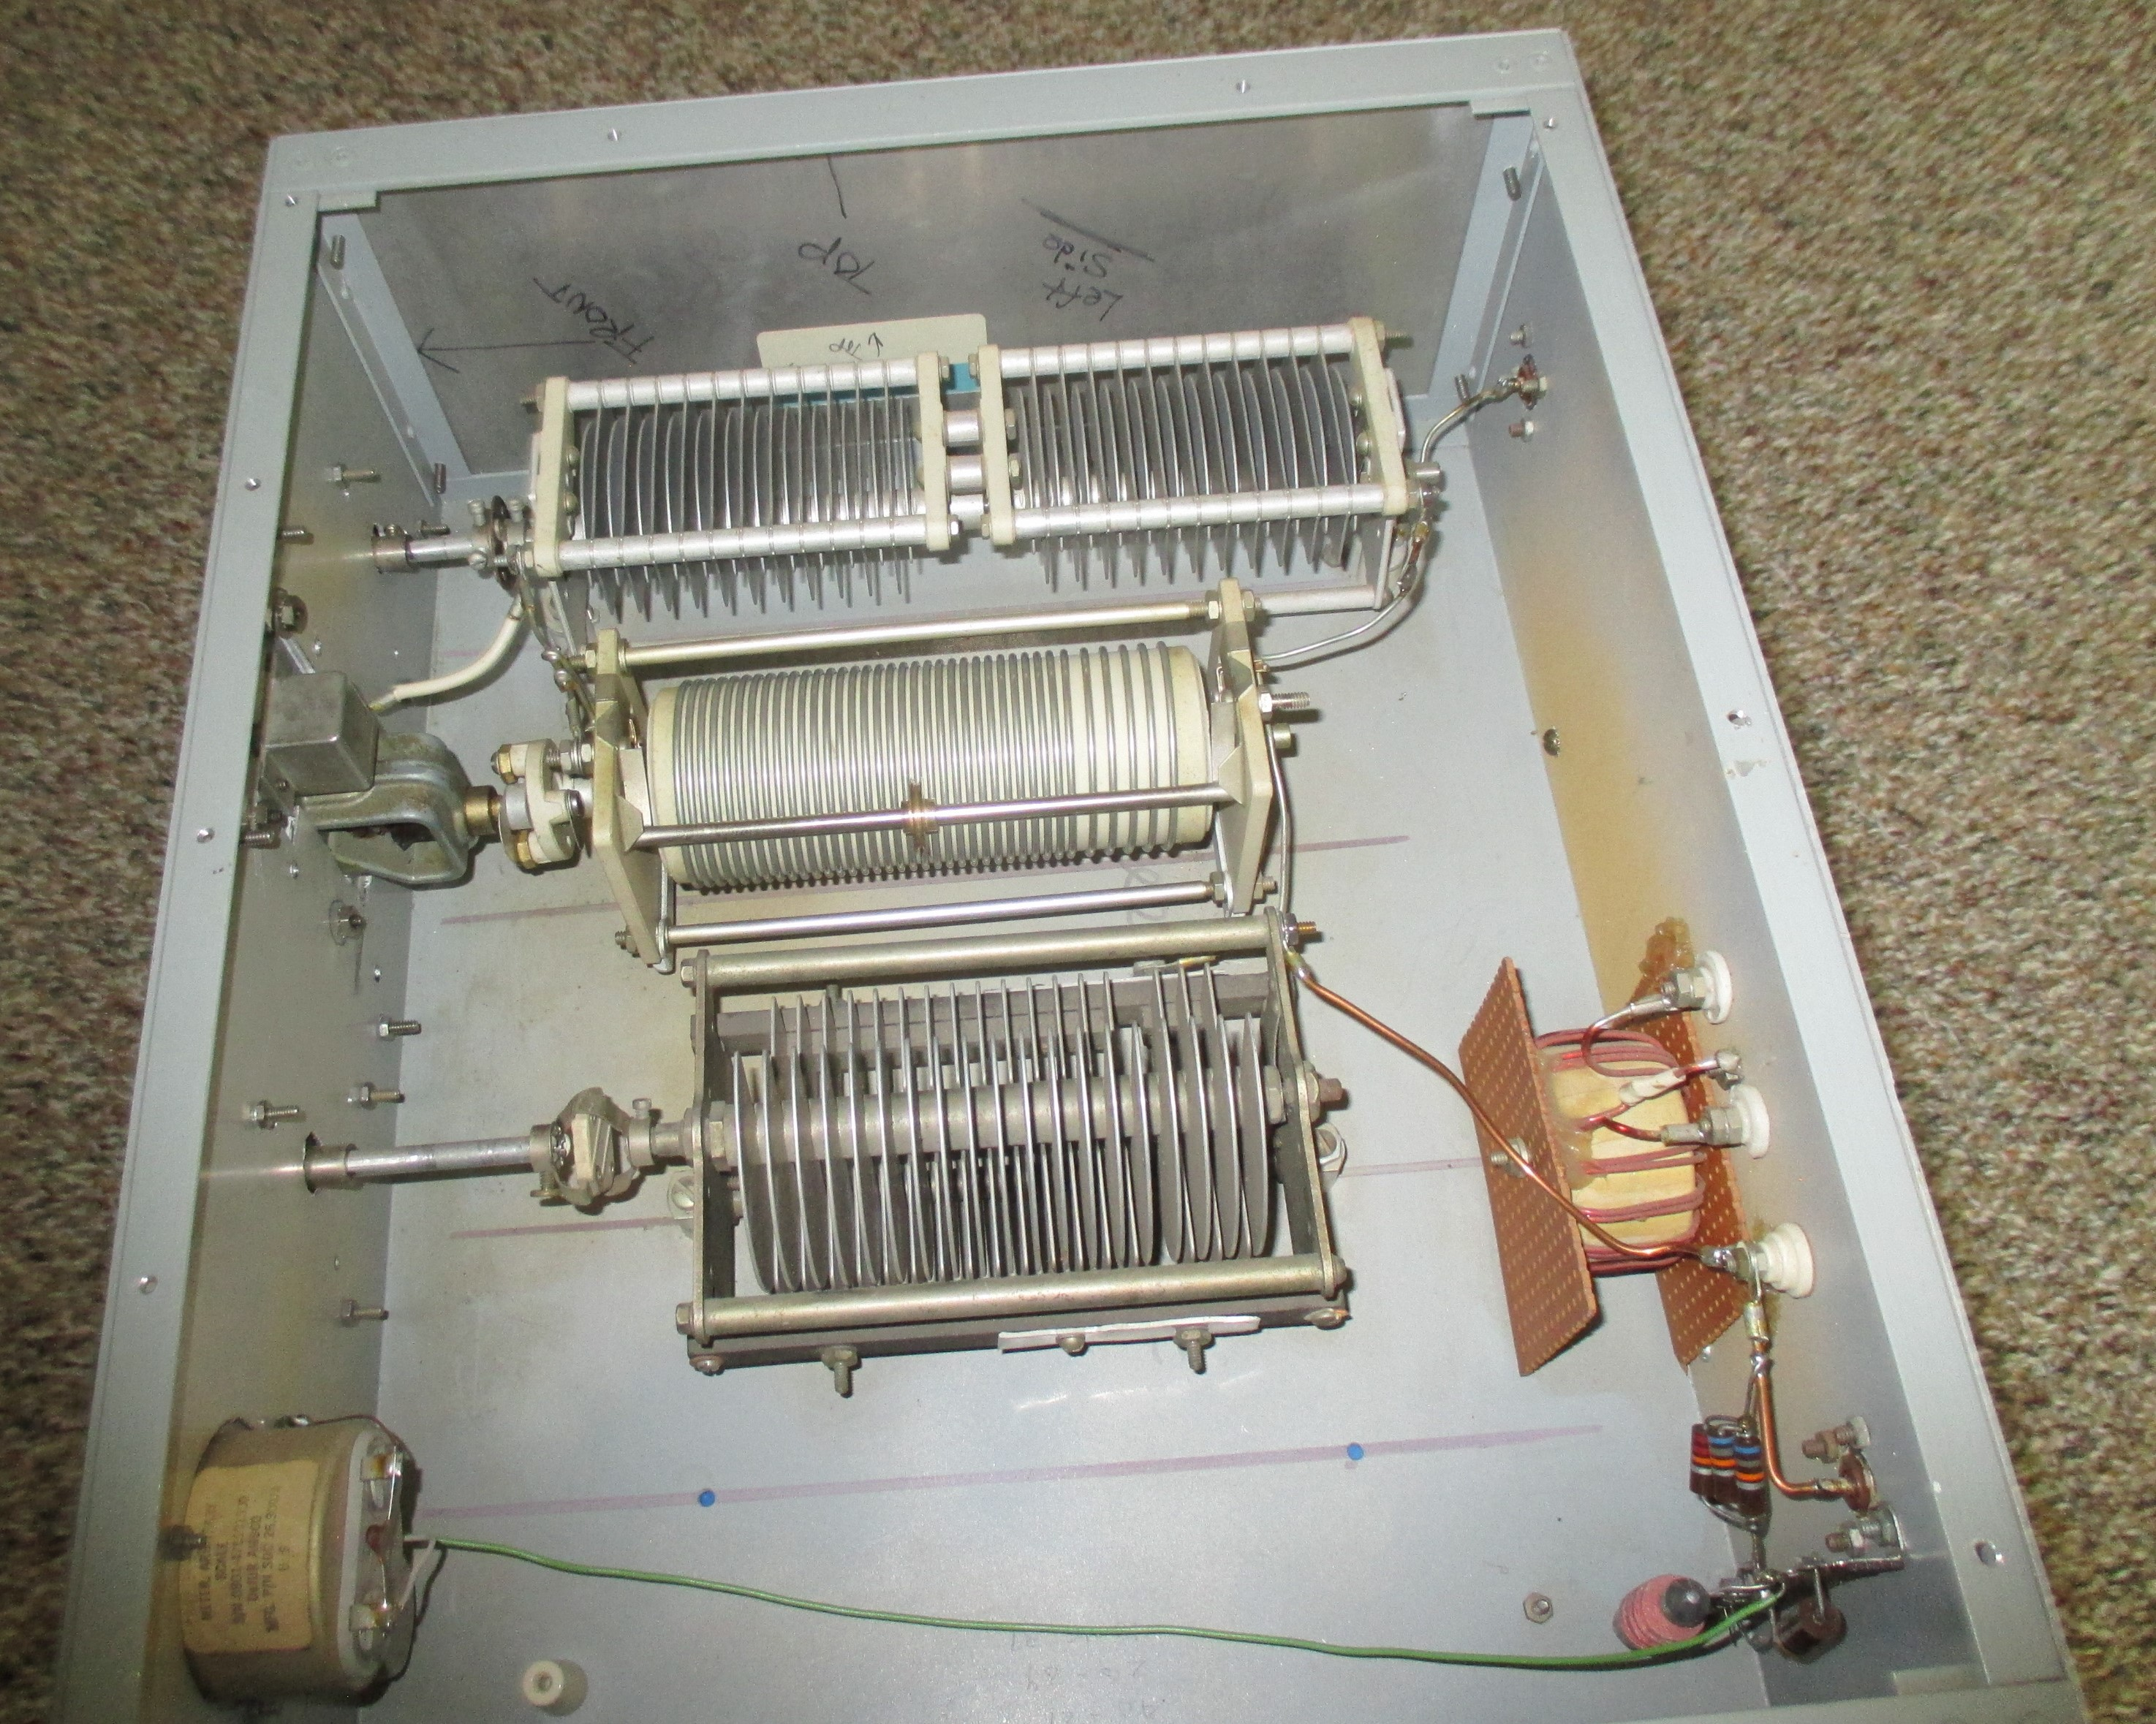

Slide 40
Final thought…..
Antenna Tuners are not hard to tune up, if you keep in mind exactly what you are trying to do and take your time!

Slide 41
Antenna Reference Books
Every Ham should own copy of the ARRL Radio Amateurs Handbook and Antenna Manual! They do not have to be the latest edition. Antenna theory hasn’t changed in 50 years! Often, older copies can be purchased at a hamfest for a few dollars.
DO YOU OWN EITHER OR BOTH??

Slide 42
Questions or Comments…

